Slide 1

Using nighttime lights, land cover, and net primary productivity to monitor regional economic development from above
Jesson A. Pagaduan

Slide 2
Outline of the presentation
Outline of the Presentation
Motivation and Literature Review
Research Objectives
Data & Methodology
Preliminary Results and Discussion
Limitations and Possible Extensions
Conclusions

Slide 3
Nighttime lights (NTL) are a useful proxy for economic activity
Motivation & Literature Review
There are three main advantages of using remote sensing data to economists: (1) access to information difficult to obtain by other means; (2) unusually high spatial resolution; and (3) wide geographic coverage (Donaldson & Storeygard, 2016).
Henderson, Storeygard, & Weil (2012) find that the structural elasticity of lights growth with respect to GDP growth is close to one using a panel of 188 countries in 1992-2008.
Chen and Nordhaus (2019) reveal that the relationship between NTL and GDP is even stronger at subnational scales. Lights predict about 89% and 61% of the variance in GDP in the metropolitan statistical areas (MSA) and state levels, respectively, in the United States.
Notes:
The first advantage is simply that remote sensing technologies can collect panel data at low marginal cost, repeatedly, and at large scale on proxies for a wide range of hard-to-measure characteristics.
night lights, precipitation, wind speed, flooding, topography, forest cover, crop choice, agricultural productivity, urban development, building type, roads, pollution, beach quality, and fish abundance
Open-source and publicly available
The second advantage of remote sensing data sources is that they are typically available at a substantially higher degree of spatial resolution than are traditional data.
Much of the publicly available satellite imagery used by economists provides readings for each of the hundreds of billions of 30-meter-by-30-meter grid cells of land surface on Earth.
coarser unit of analysis
Only rarely do social scientists enjoy the opportunities, afforded by satellites, to study data that have been collected in a consistent manner—without regard for local events like political strife or natural disasters—across borders and with uniform spatial sampling on every inhabited continent.

Slide 4
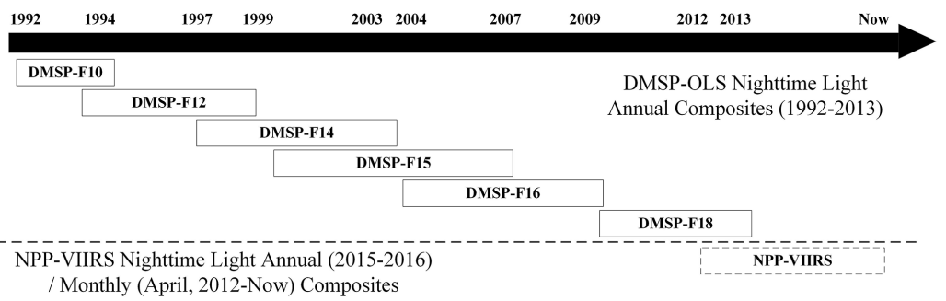
Two ntl data sources are widely used in the literature, but limited in temporal coverage
Motivation & Literature Review
The Defense Meteorological Satellite Program Operational Linescan System (DMSP-OLS) stable NTL data can only be collected from 1992 to 2013. It has disadvantages that limit its potential applications, including the absence of on-board radiance calibration, saturation issues, and blooming issues.
The Suomi National Polar-orbiting Partnership Visible Infrared Imaging Radiometer Suite (NPP-VIIRS) NTL data have better quality thanks to its higher spatial resolution and wider radiometric detection (Elvidge et al., 2013), but its short available time coverage (April 2012 to present for the monthly composites and 2015- 2016 for the annual composites) is a major source of problem for long-term analysis.
The DMSP-OLS and the NPP-VIIRS NTL data products
Source: Chen et al. (2021).

Slide 5
There were attempts to integrate the two ntl products into one extended series
Motivation & Literature Review
Few studies attempt to integrate the two NTL versions into one temporally consistent series by simulating DMSP-OLS-like series from the much better NPP-VIIRS NTL, thus the resulting extended series inherit the issues associated with DMSP-OLS NTL (see Li et al. (2020), Zhu et al. (2017), and Li et al. (2017) for examples).
Since NPP-VIIRS NTL data have a better quality than DMSP-OLS NTL data, the performance of estimating GDP at subnational scales from a simulated NPP-VIIRS-like series is much higher.

Slide 6
While it predicts economic activity in urban areas relatively well, ntl explains rural activities poorly
Motivation & Literature Review
Economic activities occurring in urban clusters are primarily services, retail, and transportation, among others, which are more likely to be captured by NTL. Unfortunately, agricultural activities, which emit less observable lighting, are concentrated mainly in the rural sector (Keola, Andersson, & Hall, 2015).
The correlation between NTL and GDP growth is stronger in places where there is less dependence in agriculture (Bundervoet, Maiyo, & Sanghi, 2015).
This poses serious underestimation for developing economies which often have, on the one hand, relatively dimly lit areas at night, and on the other, a larger share of agriculture in total GDP.

Slide 7
Research objectives
Research Objectives
We test whether NTL, augmented with land cover and NPP data, can still be a useful proxy for subnational GDP under the presence of dimly lit pixels and substantial share of less light-emitting croplands to total land area.
We explore the possibility of constructing GDP measures at the province- and city-levels using NTL, land cover, and net primary productivity (NPP) which could be useful in many applications such as granular economic assessment of natural disasters across sectors, analysis of regional inequality, and estimation of the informal sector.

Slide 8
Contributions to the literature
Research Objectives
We augment a novel NTL dataset with land cover and net primary production (NPP) data to capture economic growth across all sectors (industry and services for urban areas and agriculture for rural areas).
We use a novel NTL dataset (Chen et al. 2021) that provides an extended time series (2000-2018) of global NPP-VIIRS-like NTL data from a cross-sensor calibration. Unlike traditional studies that generate DMSP-OLS-like NTL data, Chen et al. (2021) simulate NPP-VIIRS-like data which have better quality than DMSP-OLS using deep learning technologies.
We use MDC12Q1 and MOD17A3HGF for land cover and NPP data, respectively, both of which are remote sensing data products from the Moderate Resolution Imaging Spectroradiometer (MODIS) sensors.
We study the case of the Philippines, an archipelagic country composed of dimly lit islands with substantial agriculture gross-value added (GVA).

Slide 9
An extended time series of global npp-viirs-like nighttime light data
Data & Methodology
Unlike the traditional cross-sensor calibration of NTL data by converting NPP-VIIRS to DMSP-OLS-like NTL data, Chen et al. (2021) built an extended time series (2000–2018) of NPP-VIIRS-like NTL data through a new cross-sensor calibration from DMSP-OLS NTL data (2000–2012) and a composition of monthly NPP-VIIRS NTL data (2013–2018).
Generally, the extended NPP-VIIRS-like NTL data (2000–2018) have an excellent spatial pattern and temporal consistency which are similar to the composited NPP-VIIRS NTL data.

Slide 10
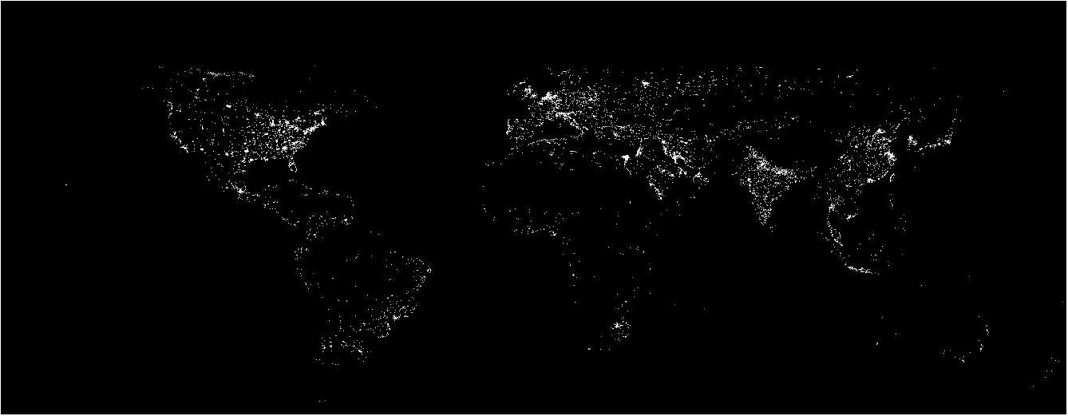
Lights at night, 2018
Data & Methodology
Source: NTL data from Chen et al. (2021).

Slide 11
Modis land cover and NPP data
Data & Methodology
The Moderate Resolution Imaging Spectroradiometer (MODIS) aboard NASA’s spacecraft Terra and Aqua produces several interesting suites of imagery with global coverage and high spatial and temporal resolution. Terra MODIS and Aqua MODIS view the Earth’s entire surface every 1 to 2 days and observations are averaged over 8 or 16 days.
MDC12Q1 is the MODIS yearly land cover product. Data are presented in tiles of approximately 1200 x 1200 km with 500 m nominal spatial resolution. We are interested in three land cover classes: IGBP class 10 (grasses/cereals), 12 (croplands), and 14 (croplands/natural vegetation mosaic).
The MOD17A3HGF V6 product provides information about annual NPP at 500m pixel resolution.

Slide 12
Economic data and others
Data & Methodology
We use Gross Regional Domestic Product (GRDP) from the Philippine Statistics Authority (PSA).
For administrative boundaries at the region-, province-, and city-levels, we use the GIS layers from PhilGIS (philgis.org) and GADM (gadm.org).

Slide 13
geoprocessing workflow
Data & Methodology
Non-Agriculture GDP from NTL
Global NTL Imagery
Extract by mask using regional boundaries from GADM
Regional NTL
Zonal Statistics
Regional Sum of NTL
Econometric Modeling
Non-agriculture GDP from NTL
Agriculture GDP from Land Cover and NPP Data
MDC12Q1 Tiles
Tabulate Area with regional boundaries
Regional croplands
Econometric Modeling
Agriculture GDP from MDC12Q1
Extract by attributes using IGBP classifications 10, 12, and 14.
MOD17A3HGF Tiles
Zonal Statistics
Regional NPP
Econometric Modeling
Agriculture GDP from MOD17A3HGF
Extract by mask using croplands

Slide 14
Less than 1% of the pixels are lit, and light intensities are very low
Preliminary Results & Discussion
Average share of unlit pixels per region, 2000-2018
Average NTL pixel intensity per province, 2000-2018
Note: Metropolitan Manila’s average share of unlit pixels for 2000-2018 is 5.86%.
Source: Author’s estimates. NTL data from Chen et al. (2021).
Source: Author’s estimates. NTL data from Chen et al. (2021).

Slide 15
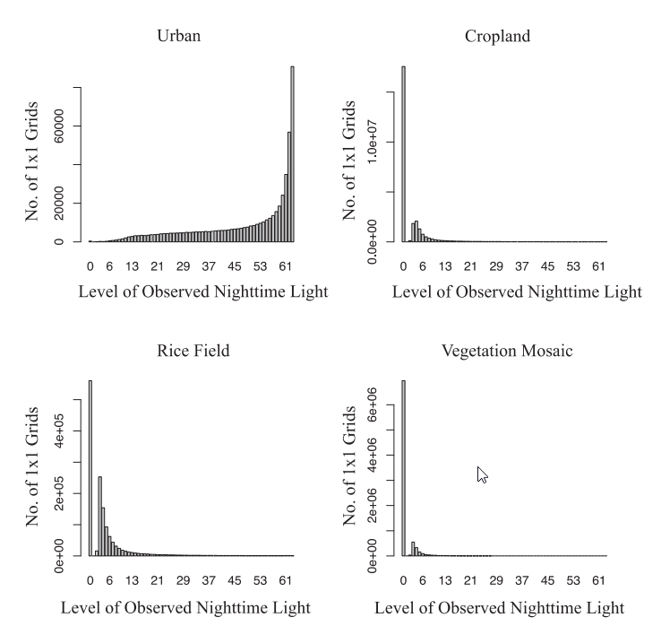
Croplands account for a sizeable share of total area across regions
Preliminary Results & Discussion
Average share of croplands area, 2001-2018
Cross-tabulation of NTL and Land Cover Classes
Source: Author’s estimates. Land cover data from MODIS.
Source: Keola, Andersson, & Hall (2015)

Slide 16
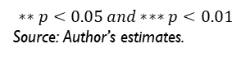
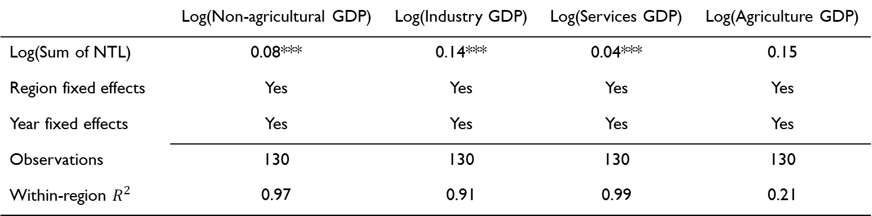
NPP-VIIRS-like ntl data predicts non-agriculture GDP, industry, and services, but not agriculture
Preliminary Results & Discussion
 | Log(Non-agricultural GDP) | Log(Industry GDP) | Log(Services GDP) | Log(Agriculture GDP)
Log(Sum of NTL) | 0.08*** | 0.14*** | 0.04*** | 0.15
Region fixed effects | Yes | Yes | Yes | Yes
Year fixed effects | Yes | Yes | Yes | Yes
Observations | 130 | 130 | 130 | 130
Within-region $R^{2}$ | 0.97 | 0.91 | 0.99 | 0.21
$$∗∗p<0.05 and∗∗∗p<0.01$$
Source: Author’s estimates.

Slide 17
NPP-VIIRS NTL predicts non-agriculture GDP relatively well for the most light-intense regions…
Preliminary Results & Discussion
Fit of non-agriculture, industry, and services GDP for Metro Manila
Source: Author’s estimates.

Slide 18
NPP-VIIRS NTL predicts non-agriculture GDP relatively well for the most light-intense regions…
Preliminary Results & Discussion
Fit of non-agriculture, industry, and services GDP for Calabarzon (Region IV-A)
Source: Author’s estimates.

Slide 19
…as well as for dimly lit regions in the archipelago
Preliminary Results & Discussion
Fit of non-agriculture, industry, and services GDP for Zamboanga Peninsula (Region IX)
Source: Author’s estimates.

Slide 20
…as well as for dimly lit regions in the archipelago
Preliminary Results & Discussion
Fit of non-agriculture, industry, and services GDP for Caraga (Region XIII)
Source: Author’s estimates.

Slide 21
HOWever, ntl explains agriculture gdp poorly especially for regions with large agriculture sector
Preliminary Results & Discussion
Fit of agriculture GDP for Central Luzon (Region III), Cagayan Valley (Region II), and Ilocos Region (Region I)
Source: Author’s estimates.

Slide 22
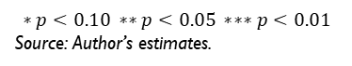
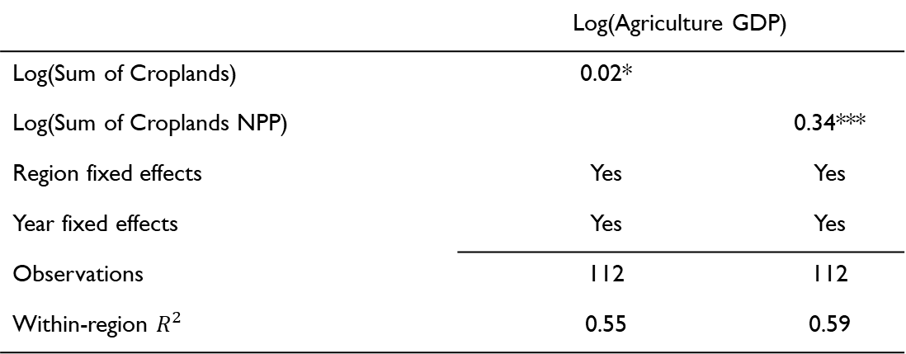
npp, in addition to land cover, predicts agriculture gdp
Preliminary Results & Discussion
 | Log(Agriculture GDP)
Log(Sum of Croplands) | 0.02*
Log(Sum of Croplands NPP) |  | 0.34***
Region fixed effects | Yes | Yes
Year fixed effects | Yes | Yes
Observations | 112 | 112
Within-region $R^{2}$ | 0.55 | 0.59
$$∗p<0.10 ∗∗p<0.05 ∗∗∗p<0.01$$
Source: Author’s estimates.

Slide 23
npp and Land cover can predict agriculture GDP relatively well
Preliminary Results & Discussion
Fit of agriculture GDP for Central Luzon (Region III), Cagayan Valley (Region II), and Ilocos Region (Region I)
Source: Author’s estimates.

Slide 24
Ntl allows for analysis of long-term dynamics of province-level gdp growth…
Preliminary Results & Discussion
Province-level average annual non-agriculture GDP growth in two subperiods
2000-2008
2009-2018

Slide 25
And Land cover for analysis of long-term dynamics of province-level agriculture gdp growth
Preliminary Results & Discussion
Province-level average annual agriculture GDP growth in two subperiods
2000-2008
2009-2018

Slide 26
Applications: analysis of the impact of natural disasters on province-level gdp growth
Preliminary Results & Discussion
Non-agriculture GDP growth for Haiyan-hit province of Leyte (Tacloban)
Non-agriculture GDP growth for Earthquake-hit provinces of Bohol and Cebu

Slide 27
Applications: The “highway effect” of the star tollway ii on industry growth in the Batangas province
Preliminary Results & Discussion
Beneficiaries group of the STAR Tollway II: Lipa City, Municipality
of Ibaan, and Batangas City
Industry growth in cities and municipalities in the Batangas province after completion of STAR Tollway II

Slide 28
limitations
Limitations
There is no formal distinction between urban and rural pixels in determining which among NTL-lit pixels reflect economic activity. This could be addressed using the Global Human Settlements Layer (GHSL).
Even with improved spatial resolution and wider radiometric detection, NPP-VIIRS NTL data product still lags against newer NTL products e.g. Luojia NTL recently developed by Wuhan University in 2018.

Slide 29
Concluding remarks
Concluding Remarks
NPP-VIIRS-like NTL can still be a good proxy for industry and services GDP at subnational scales even for dimly lit regions.
While it predicts industry and services GDP fluctuations, it explains agriculture GDP dynamics poorly.
NPP, in addition to land cover, can be used to augment NTL in explaining GDP fluctuations in the agriculture sector.
NTL, NPP and land cover data allows for construction of province- and city-level GDP measures. Applications include analysis of impacts of natural disasters at the province- and city-levels, assessment of regional inequality, estimation of informal sector, etc.

